Slide 1

Portfolio Report
Performance Analysis (July 29, 2025 - August 20, 2025)
Presented By:
Abhishek Holkar

Slide 2
Our Investment Philosophy
Core Strategy: To build a portfolio resilient to global shocks by focusing on the robust Indian domestic economy.
Key Pillars:
Domestic Consumption
Defensive Play
Growth Trend
Included Sun Pharma for stability during market uncertainty.
Added Waaree Energies to capitalize on the expanding green energy sector.
Selected companies poised to benefit from strong domestic spending (Hindustan Unilever, Asian Paints, Ultratech Cement).
Benchmark Index: Sensex

Slide 3
Indian Economic Landscape (Q1 FY 2025-26)
A Confident Picture of Sustained Expansion:
Robust GDP Growth
Estimated at 6.8%-7.0%, making India the world's fourth-largest economy.
Inflation Under Control
Retail (CPI) inflation fell to a multi-year low of 2.82% in May 2025.
Strong Sectoral Performance
Manufacturing (PMI at 14-month high), Services, and Agriculture showed strong growth.
Stable Policy Environment
RBI maintained the repo rate at 5.50%, with a continued government focus on infrastructure.
Improving Employment
Unemployment declined to a three-month low of 5.2% in July 2025.

Slide 4
Navigating Global Headwinds
01
02
03
Uncertainty Over U.S. Federal Reserve's Interest Rate Path:
Spike in Global Crude Oil Prices:
Weaker-Than-Expected Economic Data from China:
Geopolitical tensions caused Brent Crude prices to spike to ~$92/barrel.
Confirmed a faltering recovery in the world's second-largest economy.
A "hawkish" Fed stance strengthened the U.S. Dollar, leading to FII outflows from emerging markets.
Impact: Squeezed profit margins for Asian Paints and increased operational costs for HUL & Ultratech.
Impact: Directly hurt Tata Motors due to JLR's sales exposure in China and created a general "risk-off" sentiment.
Impact: Negative pressure on TCS and capital-intensive companies like Tata Motors & Ultratech Cement.

Slide 5
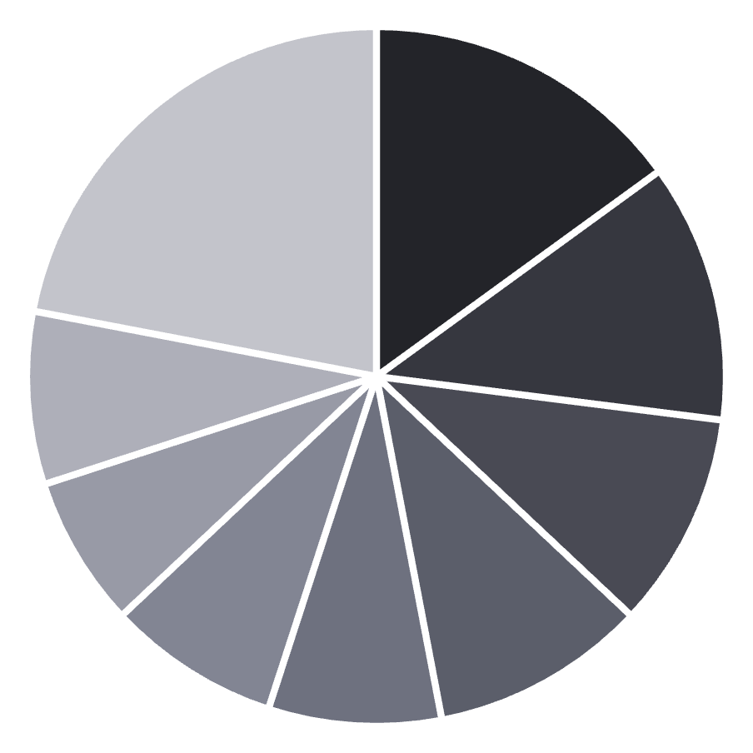
Our Diversified Portfolio
Company-wise Asset Allocation:
Sector-wise Asset Allocation:
Ultratech
Cement
Waaree
Power
TCS
IT
HUL
FMCG
Asian Paints
Chemicals
Sun Pharma
Pharma
Tata Motors
Automotive
BSE Ltd
Financial Services
Other
Other

Slide 6
Portfolio Performance vs. Benchmark
Key Metrics (29th July to 20th August, 2025):
Total Investment: ₹31,79,880
Final Value: ₹32,98,053
Net Profit: ₹1,18,173
Beating the Market:
3.72%
0.66%
3.06%
0.95
Portfolio Return
Sensex Return
Alpha Generated
Portfolio Beta
(Indicates slightly less volatility than the market)

Slide 7
Company Deep Dive: BSE Ltd
Rationale: Selected for its dominant market position, strong top-line growth (104% in FY2025) driven by increased investor participation, and anticipation of strong Q1 results.
Performance Snapshot:
Price rose on pre-result anticipation and positive brokerage reports.
A mid-period drop occurred due to a director's resignation citing regulatory conflicts.
The stock rebounded strongly on corporate updates and strategic optimism, closing higher.
Outcome (29 Jul - 20 Aug):
Investment: ₹2,48,710
Profit: +₹3,590 (+1.44%)

Slide 8
Company Deep Dive: Waaree Energies Ltd
Rationale: Chosen as a leading player in India's solar sector, backed by record Q1 module production, a strong 89% YoY profit increase, and significant capacity expansion plans.
Performance Snapshot:
Initially rallied post-announcement of strong Q1 results.
The price corrected due to growing concerns over a US anti-dumping and countervailing duty probe into Indian solar cell imports.
Outcome (29 Jul - 20 Aug):
Investment: ₹3,16,960
Loss: -₹2,760 (-0.87%)

Slide 9
Company Deep Dive: Tata Motors Ltd
Rationale: Included for its clear leadership in the Indian EV market, achieving its highest-ever monthly EV sales in July 2025, and robust year-on-year growth in commercial vehicle sales.
Performance Snapshot:
Experienced volatility due to broader market concerns over inflation and rate hikes.
Negatively impacted by weak economic data from China, a key market for its JLR brand.
Outcome (29 Jul - 20 Aug):
Investment: ₹69,235
Loss: -₹275 (-0.40%)

Slide 10
Company Deep Dive: TCS Ltd
Rationale: A core holding due to its status as a global IT leader with a highly diversified client base, consistent revenue growth, and a strong track record of returning value to shareholders via dividends.
Performance Snapshot:
Initially impacted by market-wide selling amid uncertainty in the IT sector.
Rebounded following positive cues from peer earnings.
Jumped significantly on Aug 20th after its own strong earnings report and positive management commentary.
Outcome (29 Jul - 20 Aug):
Investment: ₹3,05,600
Profit: +₹4,260 (+1.39%)

Slide 11
Company Deep Dive: Hindustan Unilever Ltd
Rationale: Selected as a defensive, market-leading FMCG company with a powerful brand portfolio, record quarterly sales, and strategic initiatives to expand into high-growth health and beauty segments.
Performance Snapshot:
Showed strong early gains reflecting high investor optimism and positive market sentiment.
Experienced a sharp correction mid-period due to profit-taking.
Recovered well in late August, driven by renewed buying interest and confidence in its stable demand.
Outcome (29 Jul - 20 Aug):
Investment:
Profit:
₹2,45,600
+₹21,200 (+8.63%)

Slide 12
Company Deep Dive: Asian Paints Ltd
Rationale: Included as the undisputed market leader in India's decorative paints sector. Key long-term driver is its heavy investment in backward integration to improve margins and reduce import dependency.
Performance Snapshot:
Benefited from falling crude oil prices, which reduce manufacturing costs.
Saw volatility linked to softer urban demand and a reported YOY profit decline in the previous quarter.
Rebounded as market sentiment improved on its structural growth prospects.
Outcome (29 Jul - 20 Aug):
Investment:
Profit:
₹2,40,600
+₹16,450 (+6.84%)

Slide 13
Company Deep Dive: Ultratech Cement Ltd
Rationale: Chosen as India's largest cement producer, set to benefit from the government's infrastructure push. Showcased robust demand, effective cost management, and a strong 49% YoY jump in Q1 net profit.
Performance Snapshot:
The stock price was relatively stable leading up to its earnings announcement.
Surged significantly after releasing strong Q1 FY26 results, which beat expectations.
Maintained positive momentum, supported by ongoing expansion plans and sound financial health.
Outcome (29 Jul - 20 Aug):
Investment:
Profit:
₹12,22,100
+₹67,800 (+5.55%)

Slide 14
Company Deep Dive: Titan Company Ltd
Rationale: A premier lifestyle brand with strong growth potential. Positioned to capitalize on rising consumer income with expanding categories in jewellery, watches, and eyewear.
Performance Snapshot:
Experienced a sharp correction early in the period due to profit-taking.
Recovered steadily on renewed investor confidence.
Surged notably after reporting a strong 52% increase in consolidated net profit for the June quarter.
Outcome (29 Jul - 20 Aug):
Investment:
Profit:
₹3,37,920
+₹21,580 (+6.39%)

Slide 15
Company Deep Dive: Sun Pharmaceutical Industries Ltd
Rationale: Included as a defensive stock, being India's largest pharmaceutical company and the world's fourth-largest specialty generic drug maker with a strong, innovative R&D pipeline.
Performance Snapshot:
The stock faced significant headwinds during the period.
A sharp price drop coincided with the National Pharmaceuticals Pricing Authority (NPPA) issuing a revised ceiling price notification, directly impacting drug pricing and margins.
Outcome (29 Jul - 20 Aug):
Investment:
Loss:
₹1,71,050
-₹7,740 (-4.52%)

Slide 16
Company Deep Dive: Piramal Pharma Ltd
Rationale: A global pharma company with diverse operations across CDMO, generics, and consumer healthcare. Selected for its ambitious long-term growth targets and commitment to sustainability.
Performance Snapshot:
The stock was under pressure after the company posted a quarterly loss of Rs 82 crore.
Despite the negative news, the stock showed resilience and stability, indicating investor confidence in its medium to long-term growth prospects.
Outcome (29 Jul - 20 Aug):
Investment:
Loss:
₹20,561
-₹1,382 (-6.72%)

Slide 17
Key Takeaways
Strategy Validation: The focus on the Indian domestic economy proved effective in a volatile global environment.
Performance: The portfolio successfully generated a positive return of 3.72% in under a month.
Outperformance: Significantly outperformed the Sensex benchmark, delivering an alpha of 3.06%.
Key Drivers: Strong performance was led by domestic-focused companies like Hindustan Unilever, Titan, and Ultratech Cement, which cushioned the portfolio against global headwinds.
Final Result: A well-diversified, domestic-centric approach delivered resilient and market-beating returns.

